Slide 1





E- COMMERCE
Team Members
Kumari Litanjila Raula
Deevika Ravindra Puthran
Sandeep Koduru
Amruth R
Nasina Vandhupriya
Shivakumar Bandagar
Tupili Lekhasri

Slide 2




Project Overview
Challenges Faced
Solution
Advantages
Disadvantages
Conclusion

Slide 3
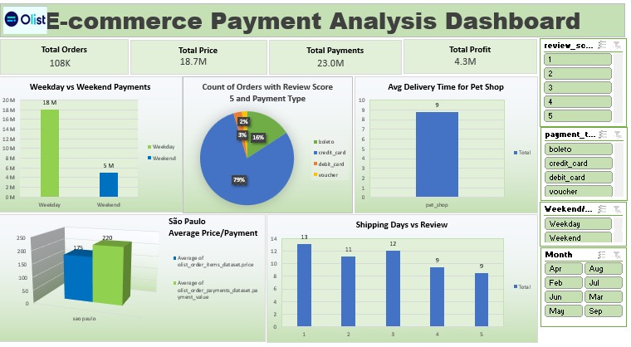
Week 1
Excel Dashboard
Excel dashboards turning e-commerce data into actionable insights

Slide 4
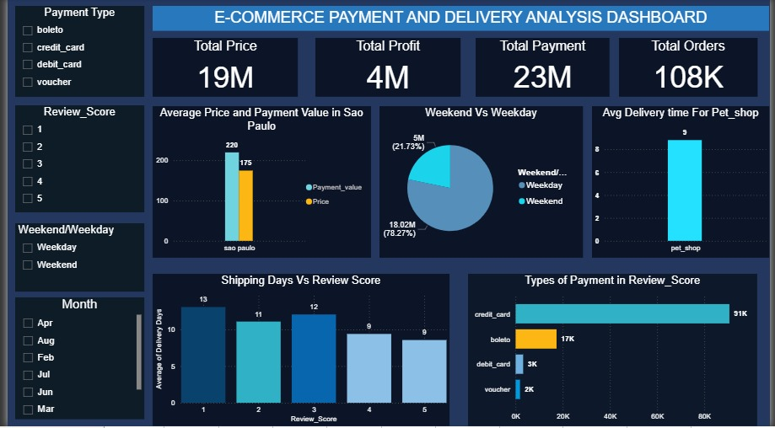
Week 2
Power BI Dashboard
Designed Power BI dashboards for trend analysis and performance tracking

Slide 5
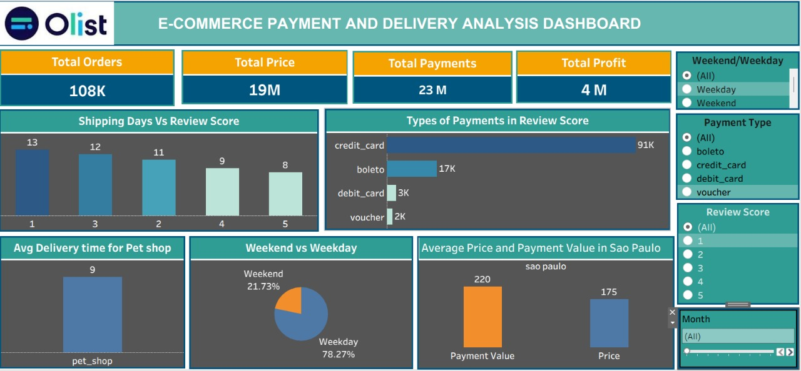
Week 3
Tableau Dashboard
Designed dynamic Tableau dashboards to track KPIs and uncover business trends.

Slide 6
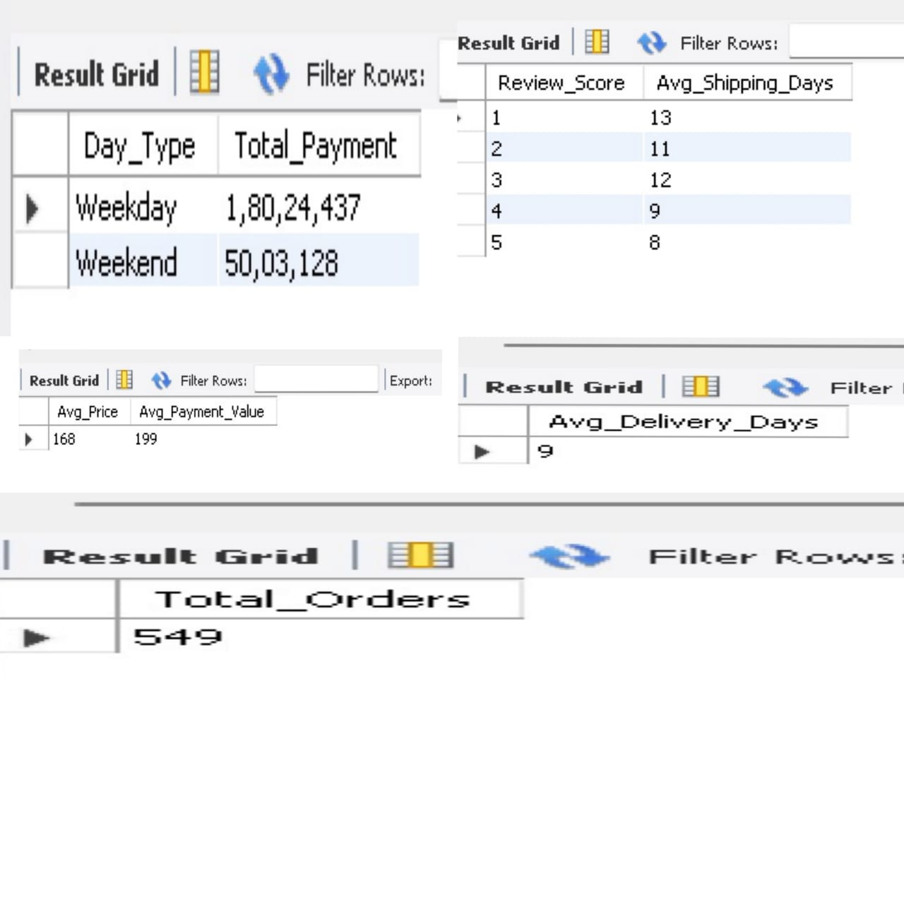
Built SQL KPIs for extracting insights directly from the database.
Week 4

Slide 7
Challenges Faced
Understanding Real time data flow
Linking multiple sheets
Blank visuals due to wrong data
Wrong Totals due to incorrect aggregation
Choosing the right chart type
Managing dashboard space
Difficulty summarizing large data into short insights

Slide 8
Solutions
Cleaned Data Properly
Double checked all links
Tried Multiple layouts
Took team feedback

Slide 9
Advantages and Disadvantages
Advantages
Quick decision making
Time saving
Easy performance tracking
Reduces human errors
Real time accuracy

Slide 10
Disadvantages
Time consuming data cleaning
Risk of linking errors
Performance issues with large data
Hard to find small errors
Dashboard sensitivity

Slide 11
CONCLUSION
Customer insights
Trend analysis
KPI dashboards
Team collaboration

Slide 12
THANK YOU

